Slide 1
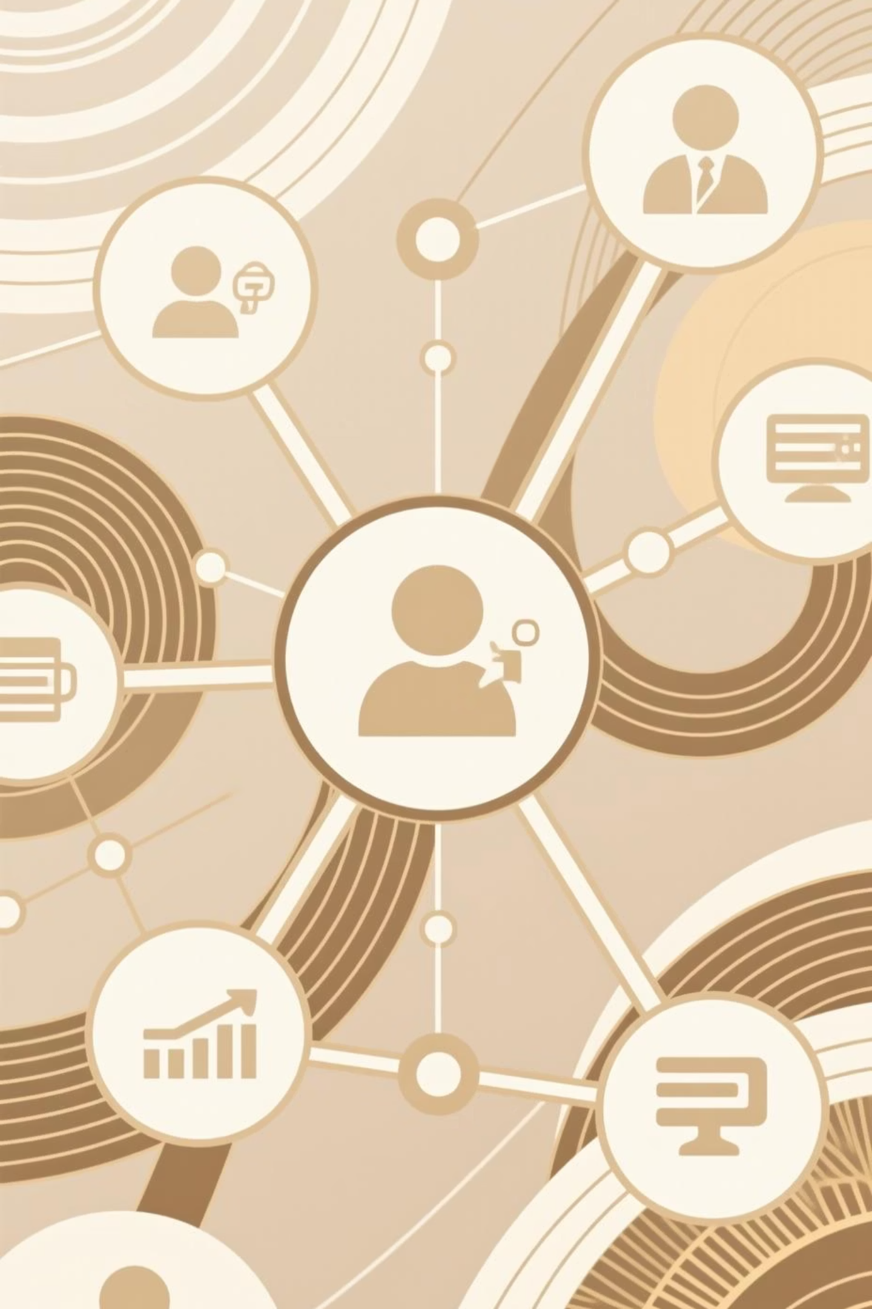
Structured CRM Journeys
Turning Data Into Seamless Experiences
How strategic lifecycle design transformed fragmented touchpoints into cohesive customer experiences that drive measurable engagement and retention

Slide 2
The Challenge: Fragmented Customer Experiences
Channel Silos
Inconsistent Messaging
Missing Roadmap
CRM efforts were scattered across email, push notifications, SMS, and in-app messaging with no coordination or unified strategy
Customers received poorly timed or conflicting messages, creating confusion and eroding trust in our brand communications
No clear connection between acquisition, engagement, and retention efforts—each team operated independently
Our Goal: Create a unified customer experience architecture that delivers measurable improvements in engagement, retention, and lifetime value

Slide 3
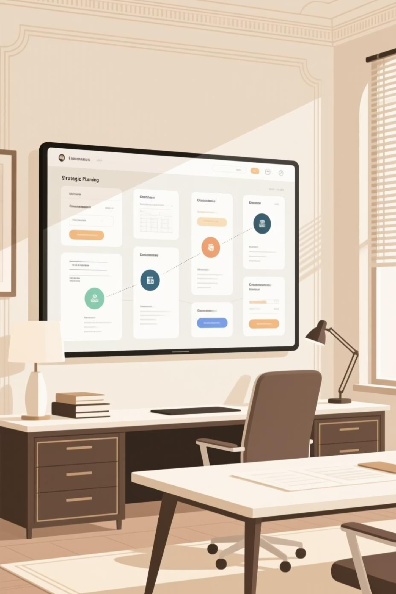
Our Strategic Approach
01
Comprehensive Touchpoint Audit
Catalogued every customer interaction across email, push, SMS, and in-app messaging to identify gaps and overlaps
02
Journey Mapping
Created detailed maps tracking the customer experience from initial signup through long-term retention milestones
03
Trigger Identification
Pinpointed key behavioral signals and lifecycle moments that indicate readiness for specific engagement
04
Rule Definition
Established clear entry criteria, exit conditions, and transition logic for each journey stage

Slide 4
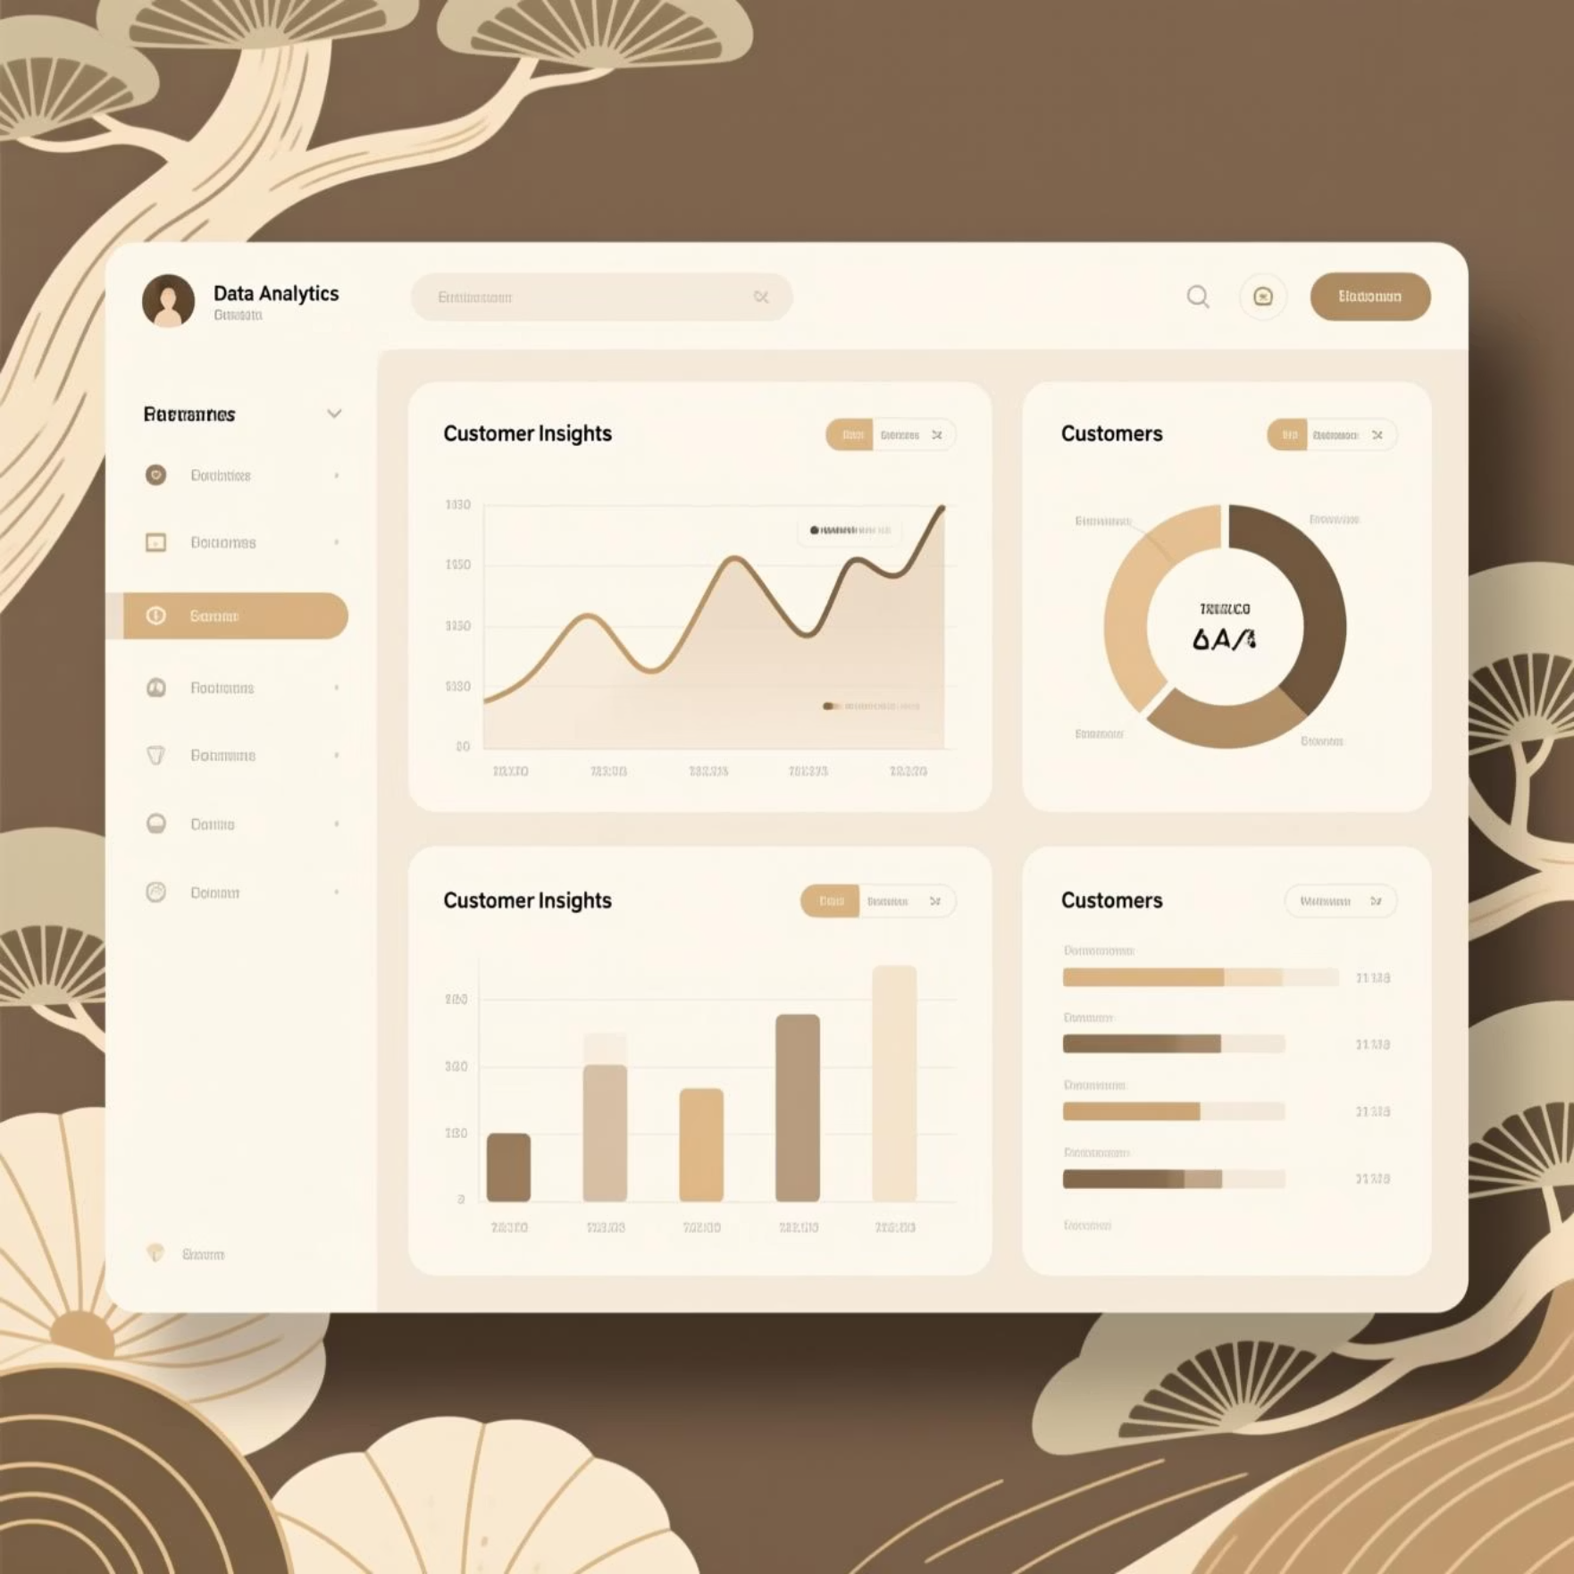
Data-Driven Foundation
Multi-Source Intelligence
We integrated behavioral tracking, transactional records, and engagement metrics to build a comprehensive view of customer activity and preferences.
Dynamic segmentation models allowed us to group customers by lifecycle stage, engagement level, and predicted actions—ensuring relevant messaging for every audience.
Behavioral Data
Transactional Data
Feature usage, page views, session duration, and interaction patterns
Purchase history, subscription status, upgrade patterns, and payment behavior
Engagement Data
Feedback Loops
Email opens, click-through rates, push opt-ins, and channel preferences
Continuous monitoring and A/B testing to refine targeting and timing

Slide 5




The Journey Framework
A structured, four-stage approach connecting every customer touchpoint into a cohesive experience that guides users from first interaction to loyal advocacy
Onboarding
Engagement
Goal: Activate new users
Goal: Drive feature adoption
Welcome series
Usage triggers
Product education
Feature discovery
Early value moments
Milestone celebrations
Retention
Re-Engagement
Goal: Build loyalty
Goal: Win back dormant users
Personalized recommendations
Inactivity detection
Renewal reminders
Win-back campaigns
Exclusive benefits
Special incentives

Slide 6
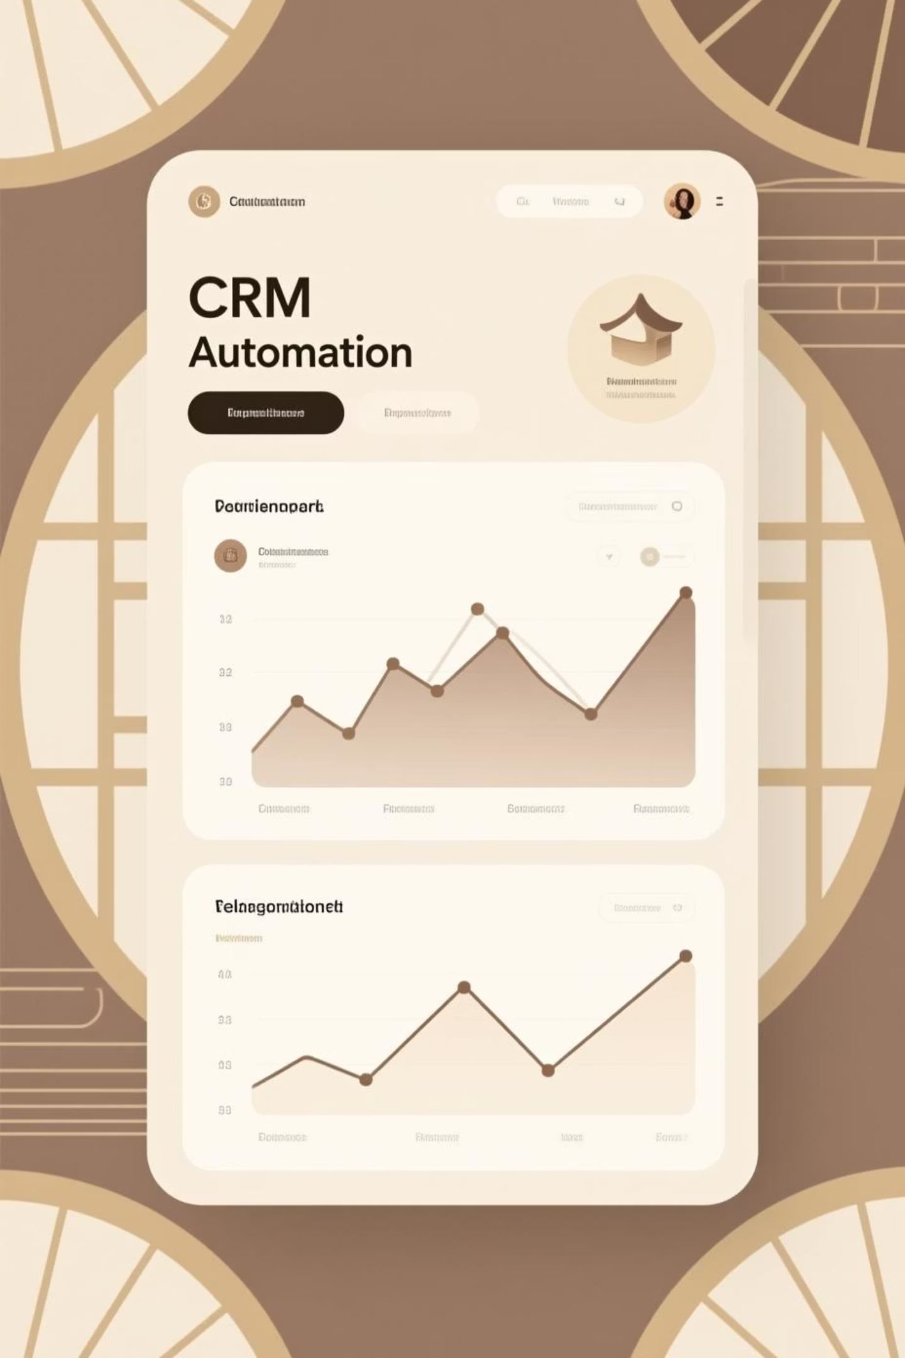
Execution Excellence
Modular Messaging Templates
Built flexible content blocks that adapt to different segments, channels, and personalization needs while maintaining brand consistency
Platform Automation
Deployed sophisticated journey logic in our CRM platform with conditional branching, time delays, and behavior-triggered progressions
Cross-Channel Orchestration
Coordinated timing across email, push, SMS, and in-app to prevent message fatigue while maximizing reach and engagement
Testing Framework
Implemented continuous A/B testing protocols from day one to measure impact and optimize every journey component

Slide 7

Measurable Results
34%
47%
52%
28%
Retention Increase
Engagement Lift
Unsubscribe Drop
Conversion Growth
Across core customer segments through personalized lifecycle messaging
In click-through rates and feature adoption compared to pre-journey baseline
Reduction in opt-outs and fatigue signals through coordinated send logic
Improvement in conversion rates through strategic personalization and timing
Structured journeys transformed scattered touchpoints into a cohesive system that improved efficiency, visibility, and business outcomes across all CRM programs

Slide 8

Key Learnings & Evolution
What We Learned
Next Phase Innovation
Scalability Through Structure
AI-Driven Send Times
Organized journey frameworks enable rapid testing and continuous optimization without rebuilding from scratch
Machine learning to predict optimal engagement windows for each individual customer
Data Alignment is Critical
Cross-channel consistency requires unified data standards and shared customer definitions across teams
Predictive Segmentation
Advanced modeling to anticipate lifecycle transitions and proactively adjust messaging
Start Simple, Then Expand
Beginning with core journeys and iterating based on performance beats trying to build everything at once
Hyper-Personalization
Dynamic content generation based on real-time behavior and preference signals

Slide 9

The Power of Structured CRM
Structured CRM isn't just about automation—it's about creating meaningful, connected experiences that put the customer at the center of every decision.
Data Clarity
Customer Focus
Transforming raw data into actionable insights that drive smarter engagement strategies
Keeping teams aligned around delivering value at every stage of the customer journey
Adaptive Strategy
Building systems that evolve with customer needs and market dynamics

Slide 10


From Fragments to Flow
By transforming disconnected touchpoints into structured journeys, we created a scalable CRM system that delivers consistent, personalized experiences—driving engagement, retention, and long-term customer value.
Ready to transform your CRM strategy? Let's discuss how structured lifecycle design can unlock growth for your organization.

